Slide 1
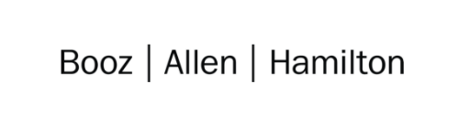

Cloud Excellence Presentation
Team 1
Members: Anjelique Butler Chris Mickey Harwinder Singh Kate Briggs Sarah Grimm
August 2021

Slide 2
TEAM 1: Project Web Application
Our Official Project for the Booze Allen Cloud Excellence Program
www.webagesolutions.com|1.877.517.6540

Slide 3
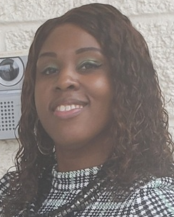

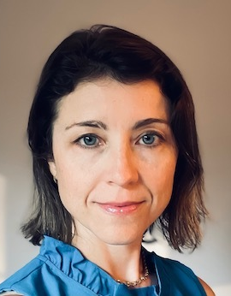

INTRODUCTIONS
ANJELIQUE BUTLER
Staff Technologist
CHRIS MICKEY
Staff Technologist
HARWINDER SINGH
Lead Technologist
KATE BRIGGS
Technologist
SARAH GRIMM
Technologist

Slide 4
Project
Introductions
Project Overview
Architecture/Design diagram
Tools/Software Environment used
Challenges/Issues/Problems/Your stories
What have you learned/learned?
What else can we do on the project? - future plan- any design and implementation ideas?
Demo
Questions and answers
International Pet Players
Web Application
www.webagesolutions.com|1.877.517.6540

Slide 5
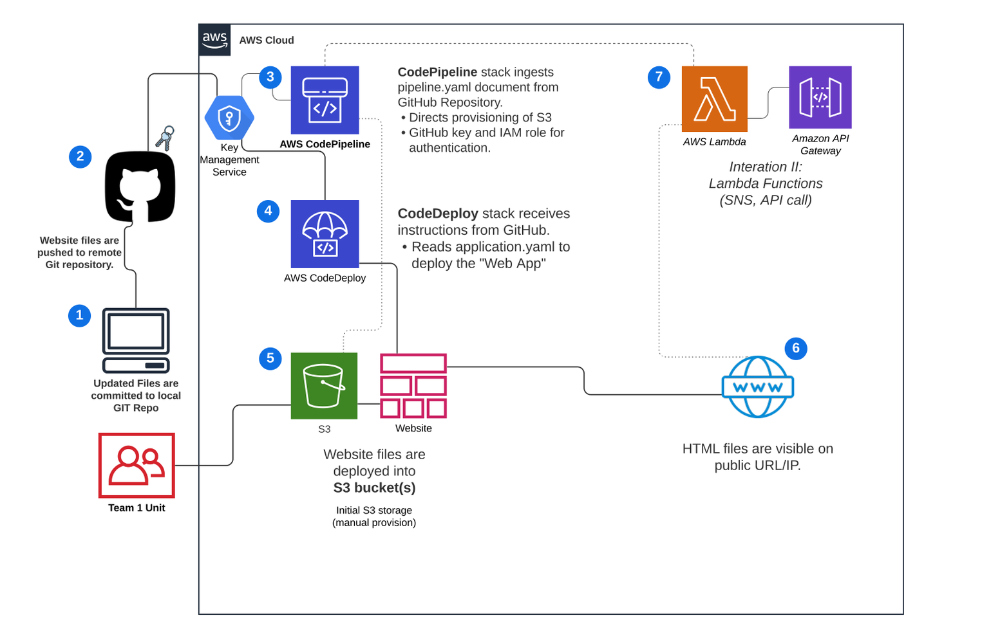
Architecture and Design

Slide 6
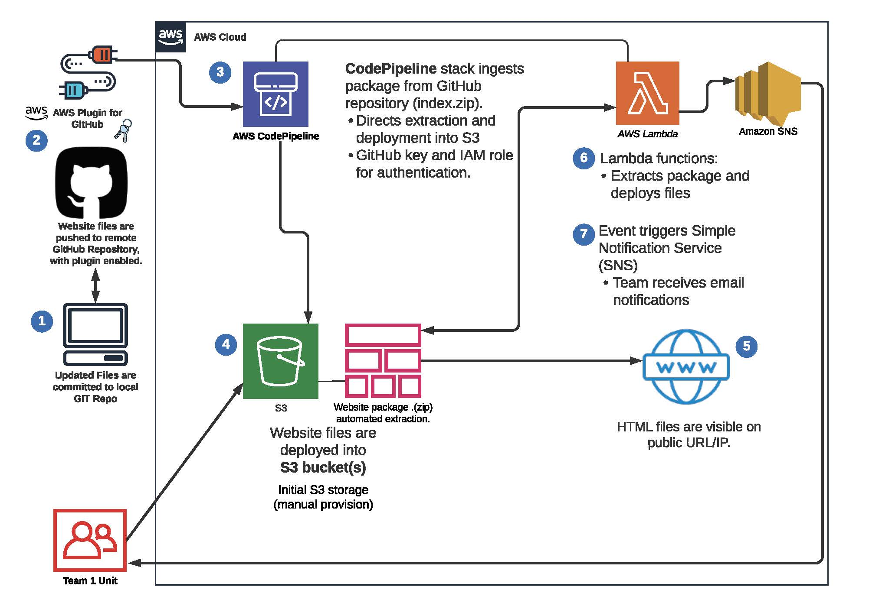

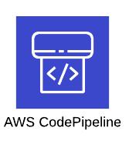

Technologies and Environment used
FEATURE | DESCRIPTION
AWS IAM | AWS identity and access management (IAM) tool for users, groups, roles and access
AWS S3 | AWS cloud storage feature, Serverless Storage Service (S3).
AWS CodePipeline | Service used to automate code deployments
AWS SNS | Simple Notification Service for enabling event-driven alerts
AWS Lambda | Serverless web service that can execute functions in python, Javascript, etc. (prebuilt or custom)
AWS CloudWatch | AWS event monitor used to view logs for infrastructure and account activity
Git with GitHub | Repository for website code and related files.
GitHub

Slide 7
Challenges and Issues
Stories about your Project
?
Issues
How to be realistic about security early in the development process
Challenges
Getting everyone set up with Git properly, some using desktop app and others CLI
Overwhelming number of services to choose from and the different options for infrastructure
Received error when trying to add SNS notification and had to troubleshoot permissions between services
Learning
When adding users, download csv right away with credentials because otherwise if screen times out, you lose session and information is gone.
S3 bucket must be in same region as pipeline when using CodePipeline
We could not see pipeline after initial execution. We realized in a different region when pipeline created and that we all need to make sure we are in the same region!
S3 bucket has to be created after SNS topic in order for notifications to work

Slide 8
Demo

Slide 9
Future State - What we would add

Slide 10
Q & A - Ask us anything

Slide 11
Thank you!!!
MARCH 2021

